Slide 1
Sales Data Task

Slide 2
Data Cleaning Process
Data was have 1 Duplicated column, so it was deleted
Data was have 4 NULL values so Remove this columns
Now Data is Clean and Ready for work on it

Slide 3
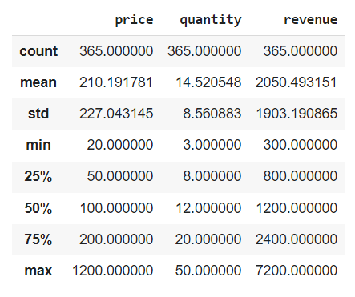
Important calculations about data

Slide 4
What was the total revenue generated by the company over the course of the year?
total revenue generated by the company over the year is: 748,430

Slide 5
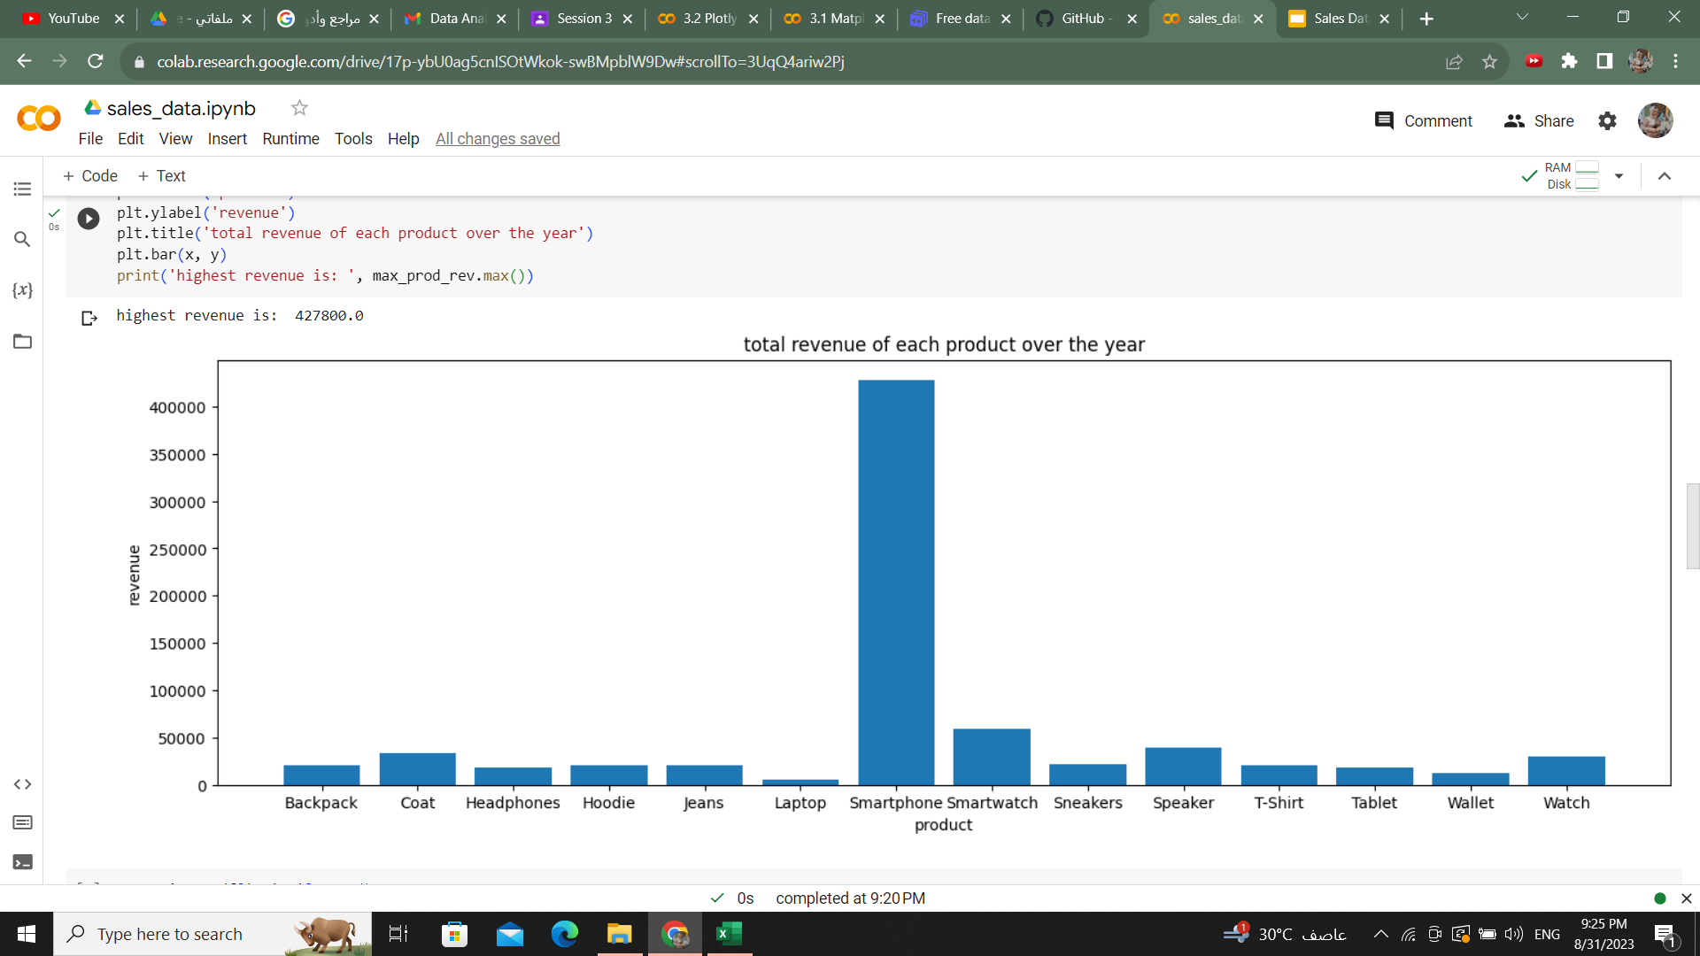
Which product had the highest revenue? How much revenue did it generate?
highest revenue is: 427,800, and the product id SmartPhones

Slide 6
What was the average price of a product sold by the company?
average price of a product sold by the company is: 210

Slide 7
What was the total quantity of products sold by the company?
total quantity of products sold by the company is: 5,300

Slide 8
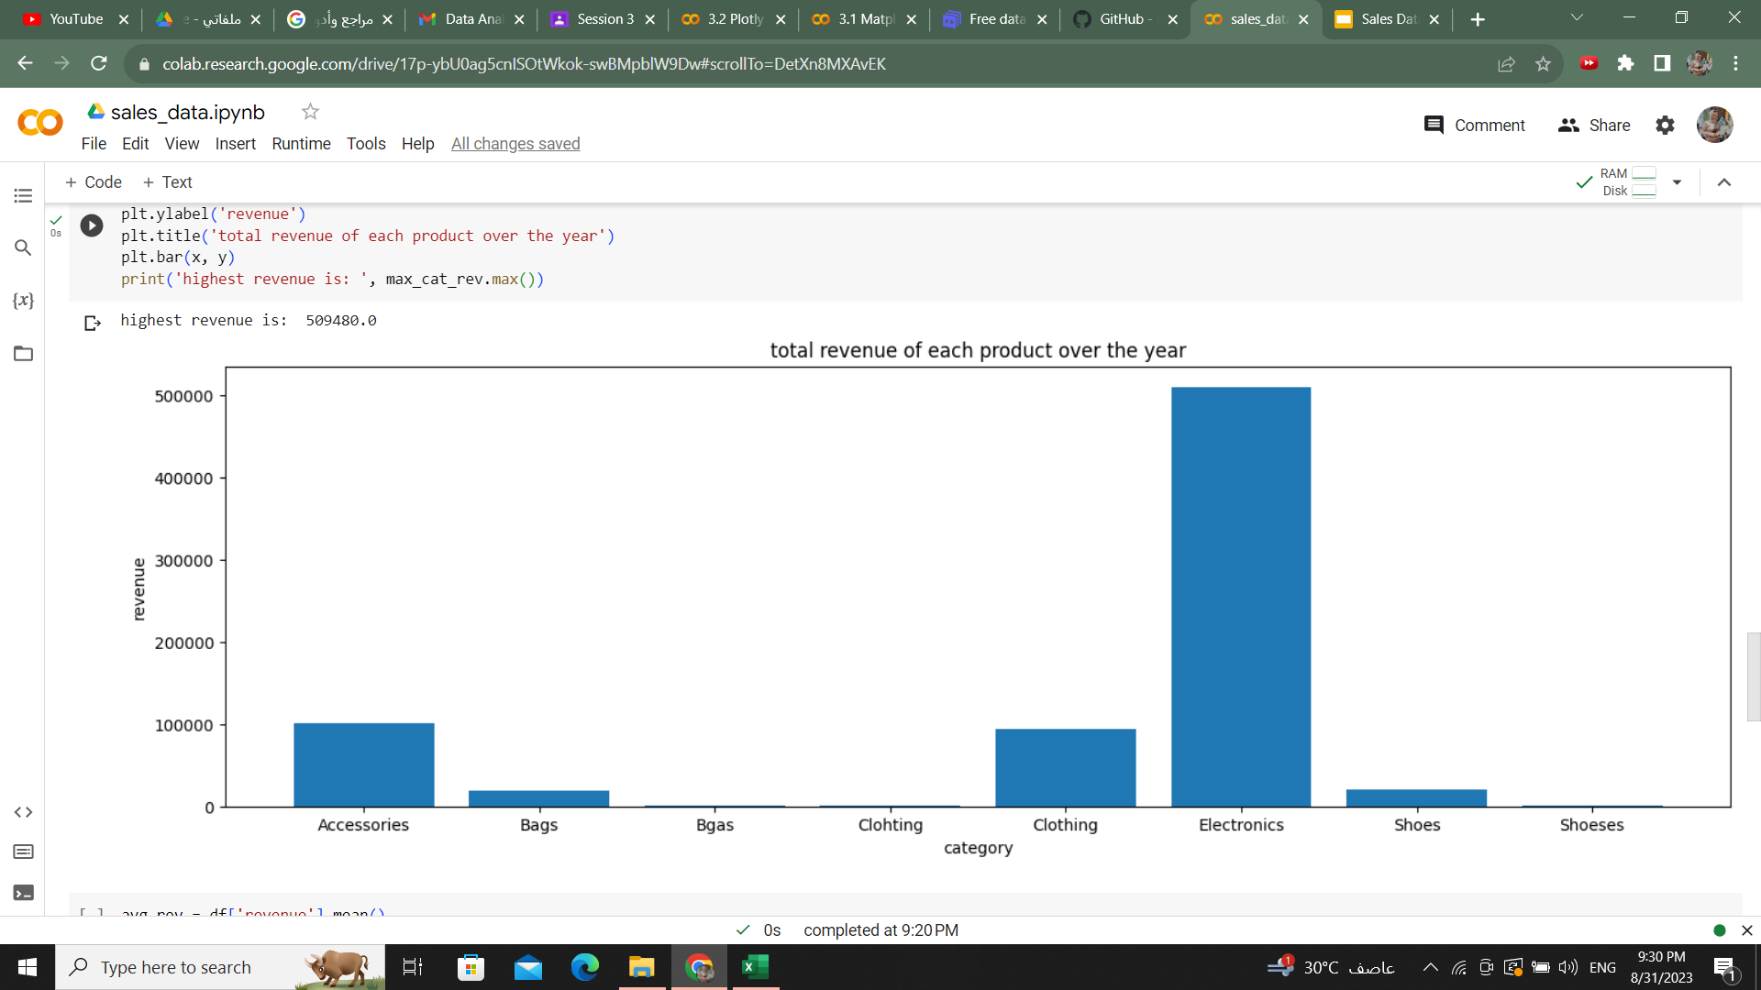
Which category had the highest revenue? How much revenue did it generate?
highest revenue is: 509,480, and the category is Electronics

Slide 9
What was the average revenue per sale?
average revenue per sale is: 2,050

Slide 10
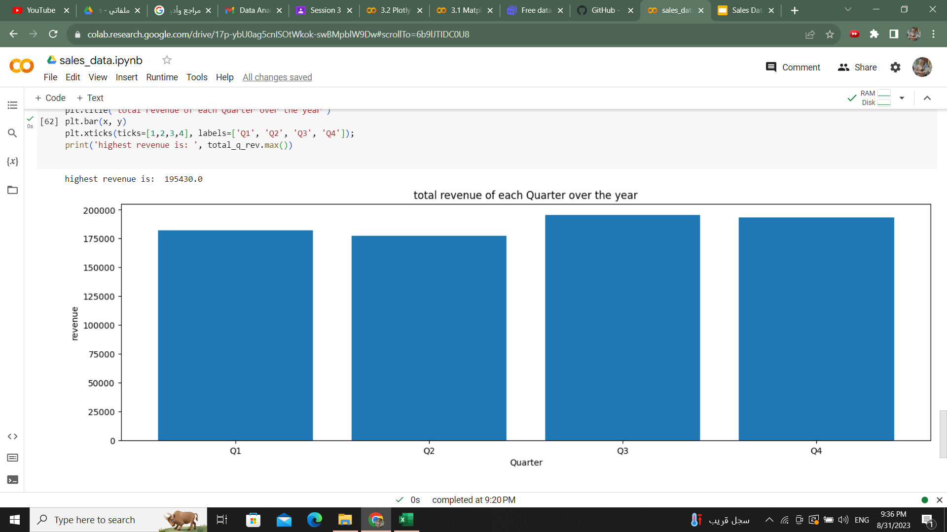
What was the total revenue generated in each quarter of the year? (i.e. Q1, Q2, Q3, Q4)
highest revenue is: 195,430, From Q3

Slide 11
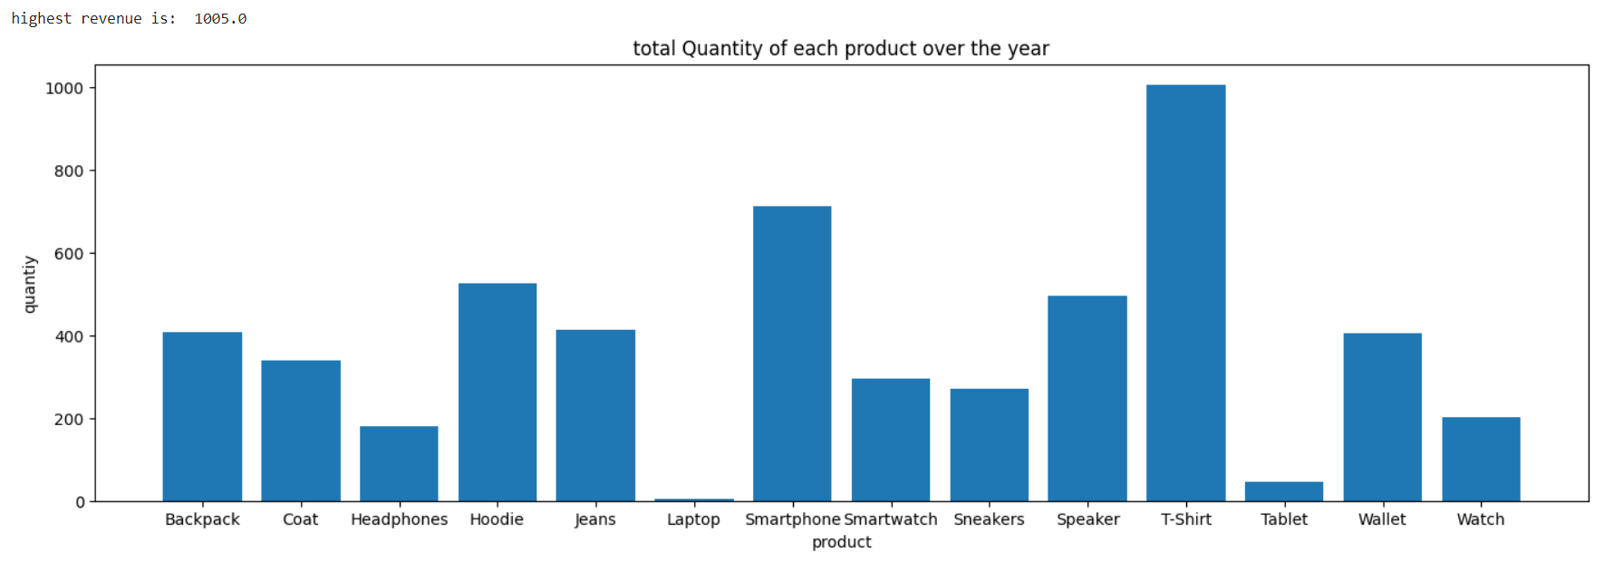
Extra! Which Product had the highest Quantity
highest Quantity is: 1,005, From T-Shirt

Slide 12
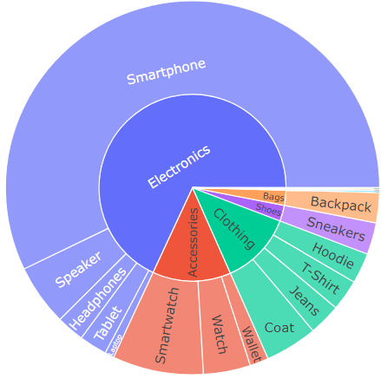
Extra! highest Revenue product of each category
smartPhone is highest product from Electronics with Revenue 427,800
smartWatch is highest product from Accessories with Revenue 58,800
Coat is highest product from Clothing with Revenue 33,800
Sneakers is highest product from shoes with Revenue 20,640

Slide 13
Summary
The average quantity sold is 14, the average Revenue is 2,050, and the price is 210
The Maximum quantity sold is 50, the Maximum Revenue is 7,200, and the Maximum price of product is 1200
The smartphone product of the electronics category has the largest revenue and is equal to 427800, and the quantity sold is about 750
The largest quantity sold was of the T-shirt product belonging to the clothing category, and the revenue from it equals 20,100 and the quantity sold is about 1,050
The largest return in Q3 is 195,430

Slide 14
Code References:
https://colab.research.google.com/drive/17p-ybU0ag5cnISOtWkok-swBMpblW9Dw?usp=sharing

